Slide 1
SoLoMo in P2P Marketplaces

Slide 2
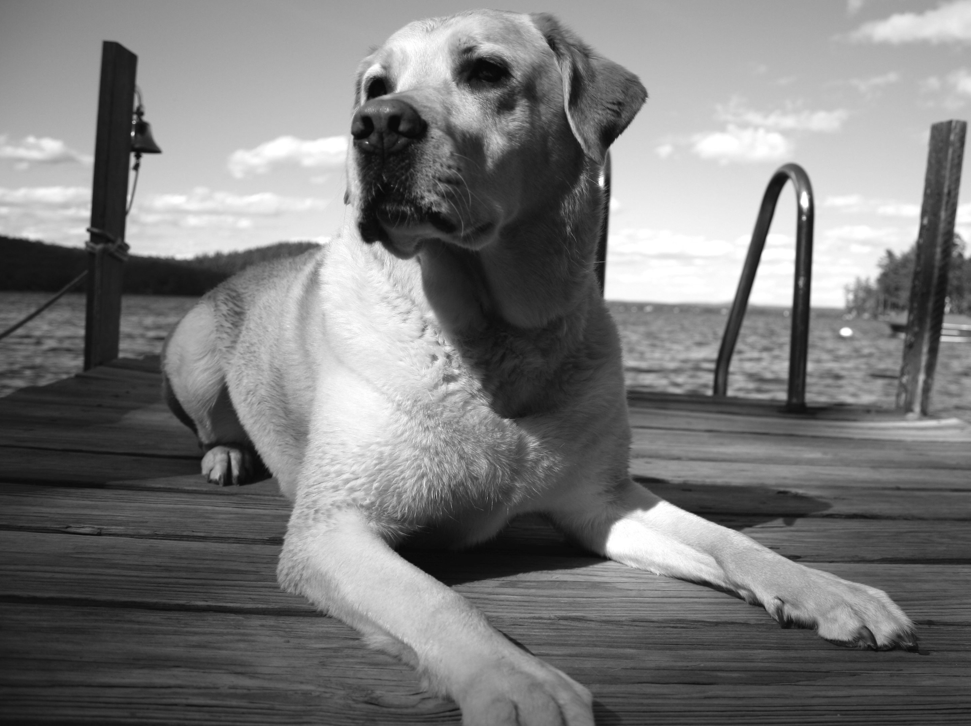

Notes:
*******************

Slide 3
SOCIAL
NETWORKING
SERVICE
NETWORKING
“The productive and service power of a web-based social networked community.”

Slide 4
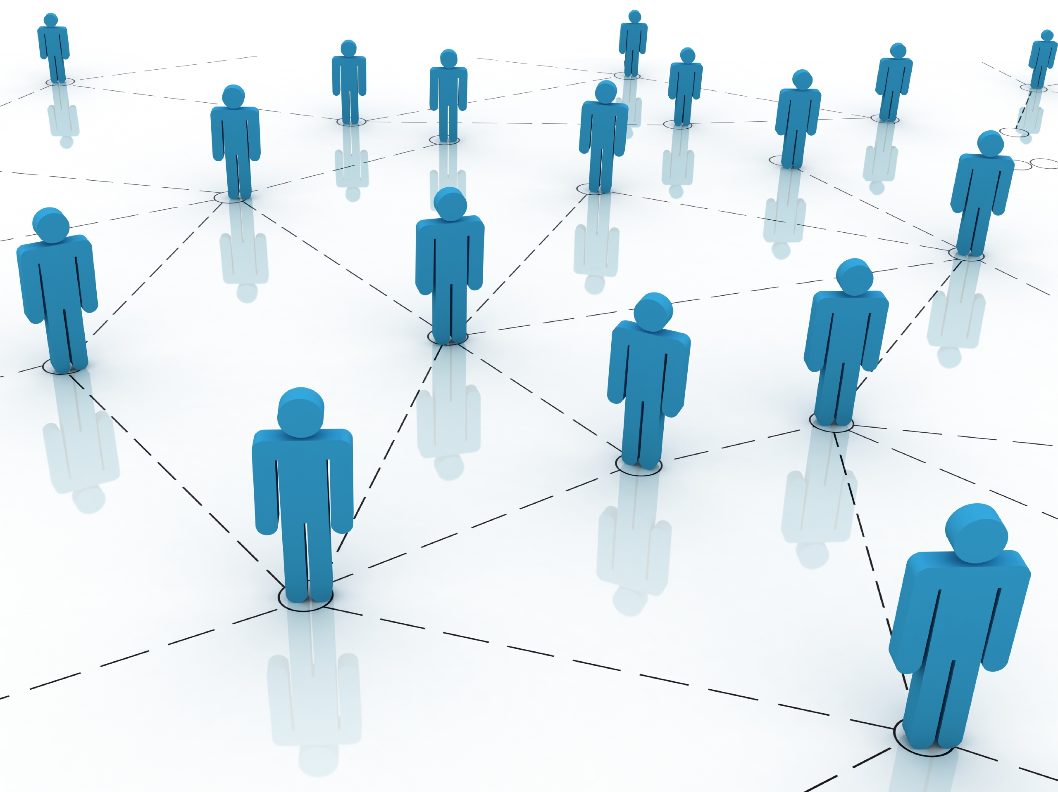
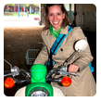
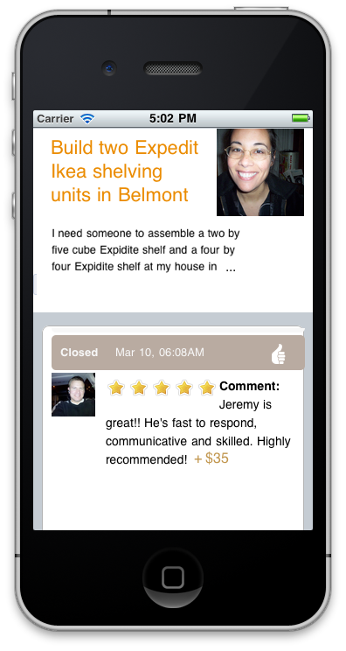
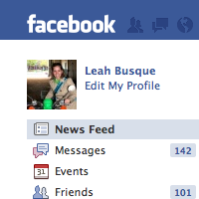
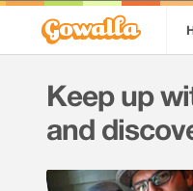

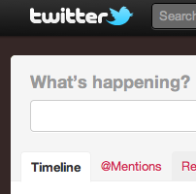
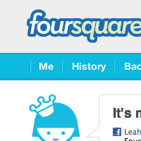
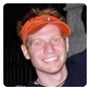

Building a trusted Service Network
Social + Location + Mobile = Service Networking
Notes:
social, location, mobile

Slide 5
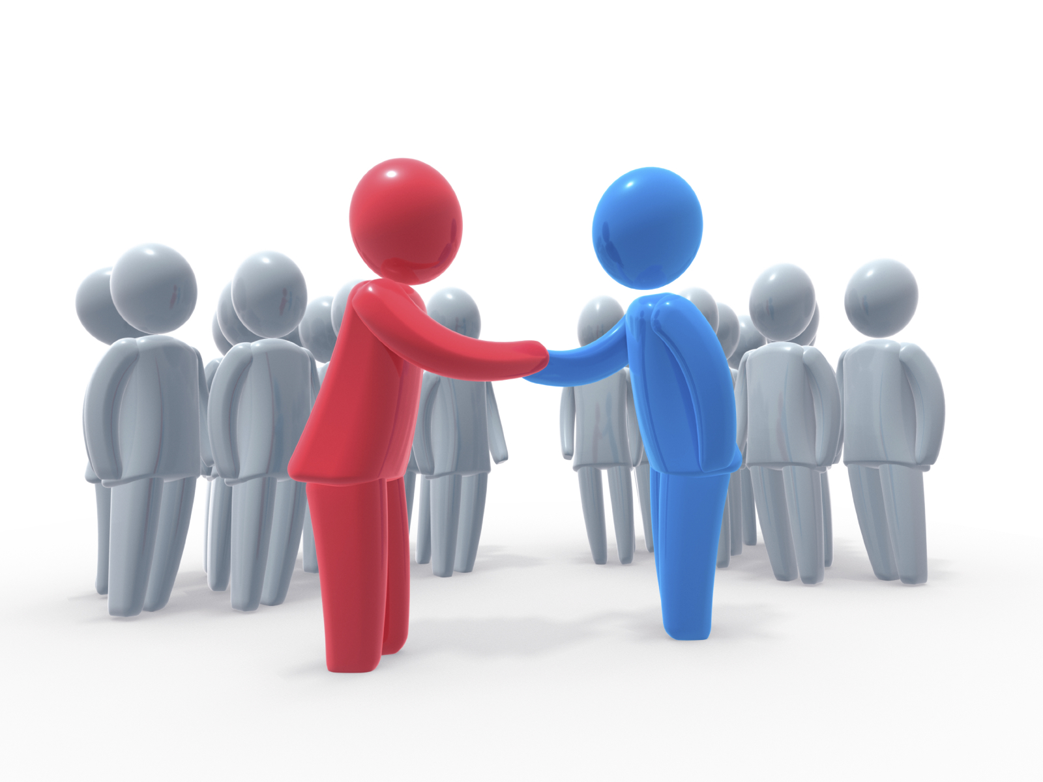
Technology enables EFFICIENCY and TRUST

Slide 6
SOCIAL
LOCATION
MOBILE

Slide 7
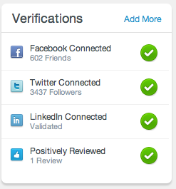
SOCIAL
Trust Building
Two pieces to Trust Building
Identity – are you who you say you are?
Reputation – what are your interactions with people?
NOT Social Media!!
Notes:
#1 – Social does not mean social media. It's not necessarily* about what your tweeting or sharing content across facebook and twitter (although these are great for awareness generation).
Leveraging Social in p2p marketplaces can build trust between people.
you are used to connecting online with people, but as soon as there is an offline connection, as there is in p2p marketplaces, there also needs to be an added layer of trust.
There are two components to trust building
**** The first is Identity – are you who you say you are? Can we verify your identity? TaskRabbit is actually handling some of this by vetting and background checking our TaskRabbit network. But another, perhaps more elegant solution is to verify a user's online identity.
Sure, identity and online profiles can be spoofed. We've all probably been friended by the spammers – who have 2 other FB connections and an empty profile.
There are also programs out there now that can generate fake FB profiles with all kinds of friend connections.
This isn't fool proof, but facebook connecting yourself to a p2p marketplace does add a layer of identity verification. The more networks you verify, the better people feel about your identity.
Having said that, this isn't completely fool proof, and I believe is too light weight of a solution. That's why we've invested a lot of time and money at TaskRabbit into our extensive background checking process.
*** The 2nd piece of trust building is Reputation.
- Seeing that someone has 600 FB friends over 500 LinkedIn connections does show a level of reputation. That this person is connected online.
- It's interesting to consider the differences in social networks – for instance FB being very social, LinkedIn for professional networking, and Twitter a completely open social sharing platform.
- The differences in the type of social network garner different levels of trust and reputation building.

Slide 8
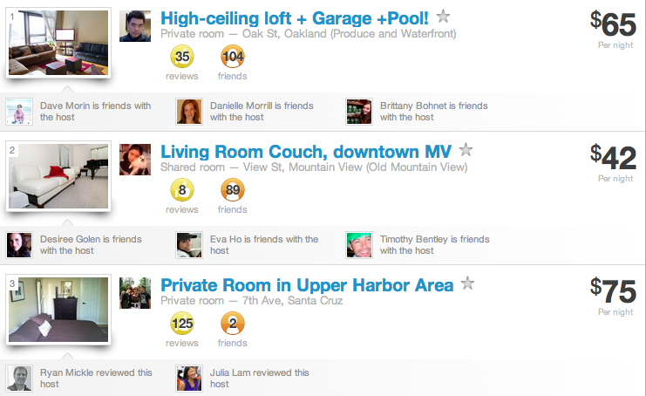
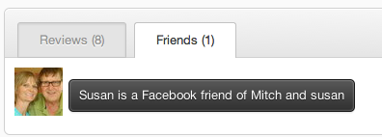
SOCIAL
Notes:
- Point out social connected features
- you can see which one of your friends knows the host
- you can see which of your friends reviewed the host
- you are more likely to trust your friends recommendations
- The world just got a lot smaller .... You can even see how you are connected to a host.
- On TaskRabbit, you can imagine being able to see which one of your friends has used a certain TaskRabbit and how they've rated and reviewed them.
- If one of your friends has had a great experience with a TaskRabbit, you are more likely to trust that person as well, particularly if you are doing similar jobs as your friends
- You may not be directly connected with your TaskRabbit, but we can also show you the degrees of separation, just like this example on Airbnb.
- Its interesting to think about how different social networks like FB and LinkedIn, might have different implications for trust. Are you typically closer with your FB friends and linkedin is more for professional networking? As I mentioned before, Twitter is an entirely different story, because its not really a social network, it's a social sharing platform. Relationships are built as tightly there and may not matter as much when you are looking for ways to build trust offline.

Slide 9
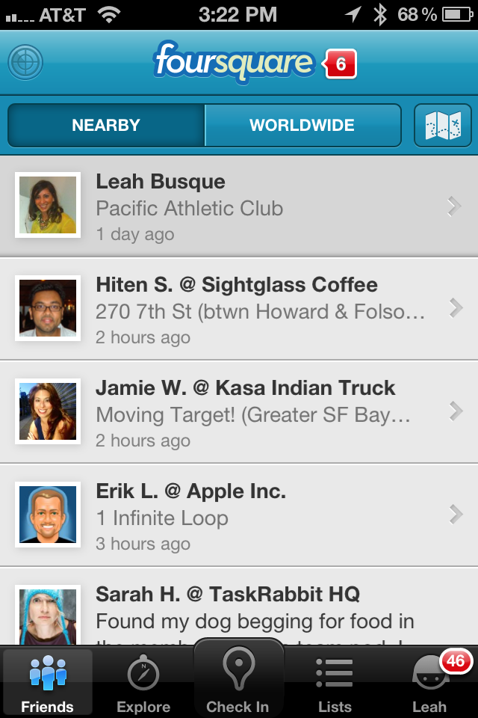
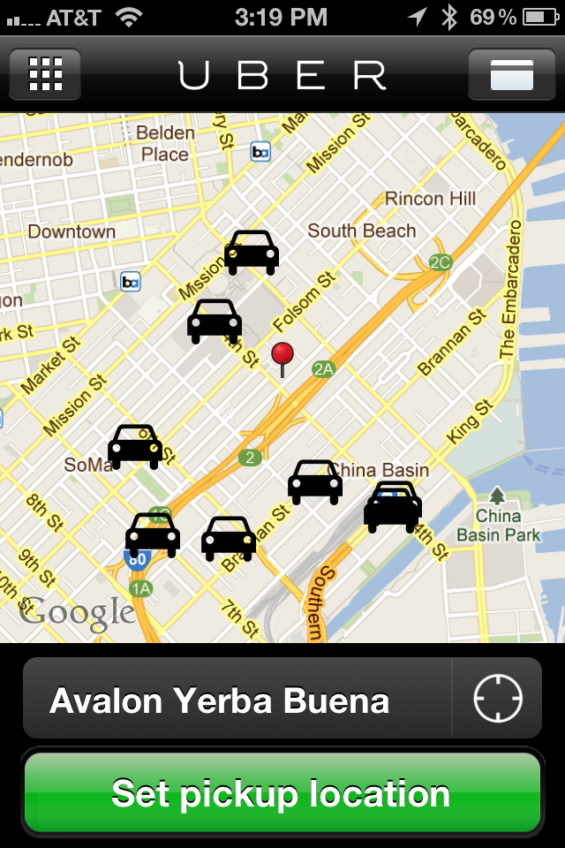
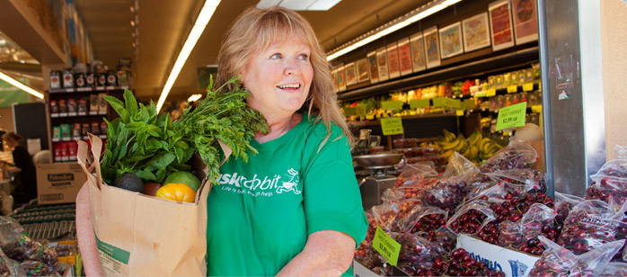
LOCATION
Trust Building
Real Time
Notes:
Location provides obvious benefits – context about where someone is located or where a property is.
For p2p marketplaces there are some interesting application of location which are really important.
- trust building – if you know someone always goes to the same neighborhood gym as you on FourSquare, would you be more likely to trust them? Perhaps.
- real time nature – location provides instant access to people and things around you. If they are available, and they are near by, they are suddenly accessible.
- these two paired together trust + ondemand nature is the perfect storm for the p2p world. Its how you are able to provide context and transparency to the offline piece of the connection. p2p is different because the online piece of the experience is only 1/2 of what the consumer experiences. There is an entire offline component. When location can be leveraged to provide transparency to the offline interaction as well, such as how far away someone is, are they on their way, etc, this is how the offline connection is provided with context.

Slide 10
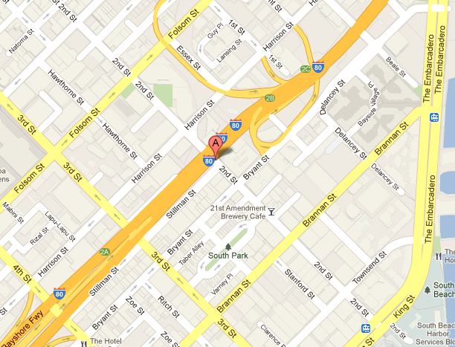
LOCATION
Intelligence
0 minutes
10 minutes
20 minutes
30 minutes
Everyone!
Notes:
- Location allows you to make smart choices about user experience interactions based on location. Example: TR alerting system
- you can do things like smart alerting – for us, when a job is posted we alert the closet TaskRabbits first.
- This allows for under 20 minute response times.

Slide 11
MOBILE
Signature Interactions
The Carousel
Voice recording a description
Histogram of pricing history
✔
posting a task
✔
no typing
✔
< 30 seconds
Notes:
For me and my passion for product, one aspect of mobile I believe can be really key in building a great user experience for your members – focus on what I would call signature interactions
If you are thinking about building on mobile, don't just port the UX from the web.
There is a huge opportunity on mobile to re-think clunky interactions on the web and elegantly solve them on mobile.
When we were building out the first version of our iPhone App we decided we had 3 high level goals for the 1st iteration of the project. We then thought about how we could make innovative UX solves to support these goals.
what were the 3 sig interactions we would focus on? how would they support our high level goals for the project? How can we make them memorable?

Slide 12
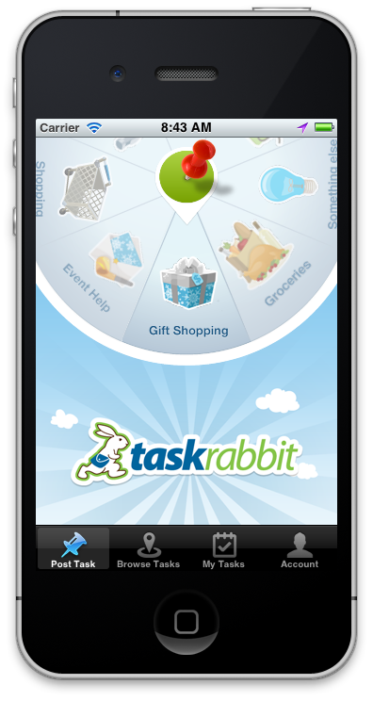
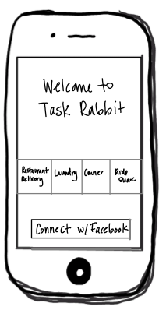
The Carousel
Notes:
best example of design and development converging into something awesome – 2 reasons
1 -
the actual code involved to make this carousel spin is non trivial. Thanks to Brian our VPE, he spent a full weekend tweaking the trig equations to get this just right. A fun engineering challenge that compliments a useful and gorgeous design.
2 –
because 1 wedge is out of view, we came up with the idea to be able to dynamically load an infinite amount of tasks into the carousel from the server at any given time
no waiting to submit to the app store to add more task types in
being able cater the experience depending on the user is also hugely powerful
LESSSON LEARNED
- particularly on mobile, push the design and dev boundaries so that you can leverage server infrastructure. what can you make dynamic and not 100% reliant on the visual UI.

Slide 13
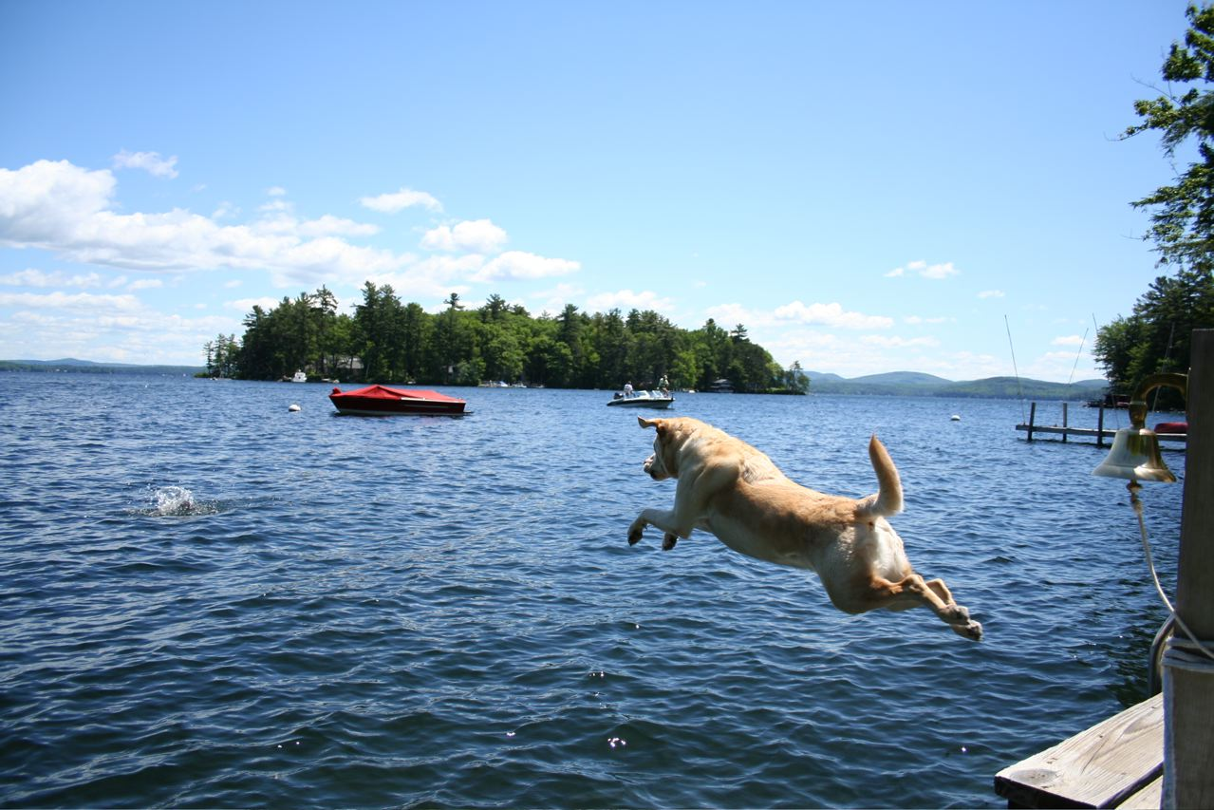
@Labusque
@TaskRabbit
Notes:
As an engineer turned entrepreneur, I encourage you to take the leap. If you are passionate about an idea – trust yourself to figure it out

